Slide 1

PYTHON PROJECT
THE STORY OF PALESTINE THROUGH DATA
BY: MD Mahmudur Rahman

Slide 2

SITUATION
I was working with a dataset containing information about fatalities in the Israeli-Palestinian conflict from 2000 to 2023. The data included details such as the date of events, age and citizenship of victims, location, and cause of death.

Slide 3
TASK
My task was to analyze this data to uncover trends, patterns, and insights about the fatalities over time. I aimed to create visualizations and statistical summaries to better understand the demographics of the victims and the nature of the conflict.

Slide 4
ACTION
DATA CLEANING
Missing Values: Handle missing values appropriately.
Date Parsing: Ensure dates are in a proper datetime format.
Consistency: Standardize categorical values.
Remove Unnecessary Columns: Drop columns that might not be useful for the analysis.

Slide 5
ACTION
EXPLORATORY DATA ANALYSIS
Temporal Trends: Observing how the number of fatalities has changed over time, identifying any significant peaks or declines, and correlating these with historical events.
Regional Analysis: Understanding which regions have been most affected by the conflict.
Causes of Fatalities: Identifying the most common causes of fatalities in the dataset.
Yearly Trends: Highlighting any particular years with unusually high or low numbers of fatalities.
Correlation Analysis: Understanding relationships between different numerical variables in the dataset.
Age and Gender Distribution: Analyzed the age and gender demographics of the fatalities.
Citizenship Analysis: Investigated the citizenship distribution, highlighting the disproportionate impact on Palestinians.
Geographic Distribution: Mapped fatalities across different districts using geospatial analysis.
Participation in Hostilities: Evaluated the extent of involvement in hostilities among the deceased.
Types of Injuries and Methods: Assessed the types of injuries and means of killing.
Historical Events Analysis: Examined key events and trends like the Jenin massacre (2002), Second Intifada, and 2014 Gaza War.

Slide 6
ACTION
METHODS
I used libraries such as pandas for data manipulation, matplotlib and seaborn for visualization, and folium for mapping.
I created detailed visualizations comparing Palestinian and Israeli fatalities over the years.
I provided historical context for significant events, such as the Jenin massacre in 2002 and the 2014 Gaza War.

Slide 7
RESULTS
DATA CLEANING SUMMARY
The dataset initially had 11,124 entries with 16 columns. After cleaning, the dataset now contains 4,661 entries with the same number of columns. The cleaning process involved:
Standardizing column names.
Dropping rows with missing values.
Removing duplicate records.
Converting the date column to datetime format.
Here is a summary of the cleaned dataset:
The dataset contains information such as name, date_of_event, age, citizenship, event_location, event_location_district, event_location_region, date_of_death, gender, took_part_in_the_hostilities, place_of_residence, place_of_residence_district, type_of_injury, ammunition, killed_by, and notes.
Columns like type_of_injury, ammunition, and notes have been significantly reduced due to the removal of rows with missing values.

Slide 8
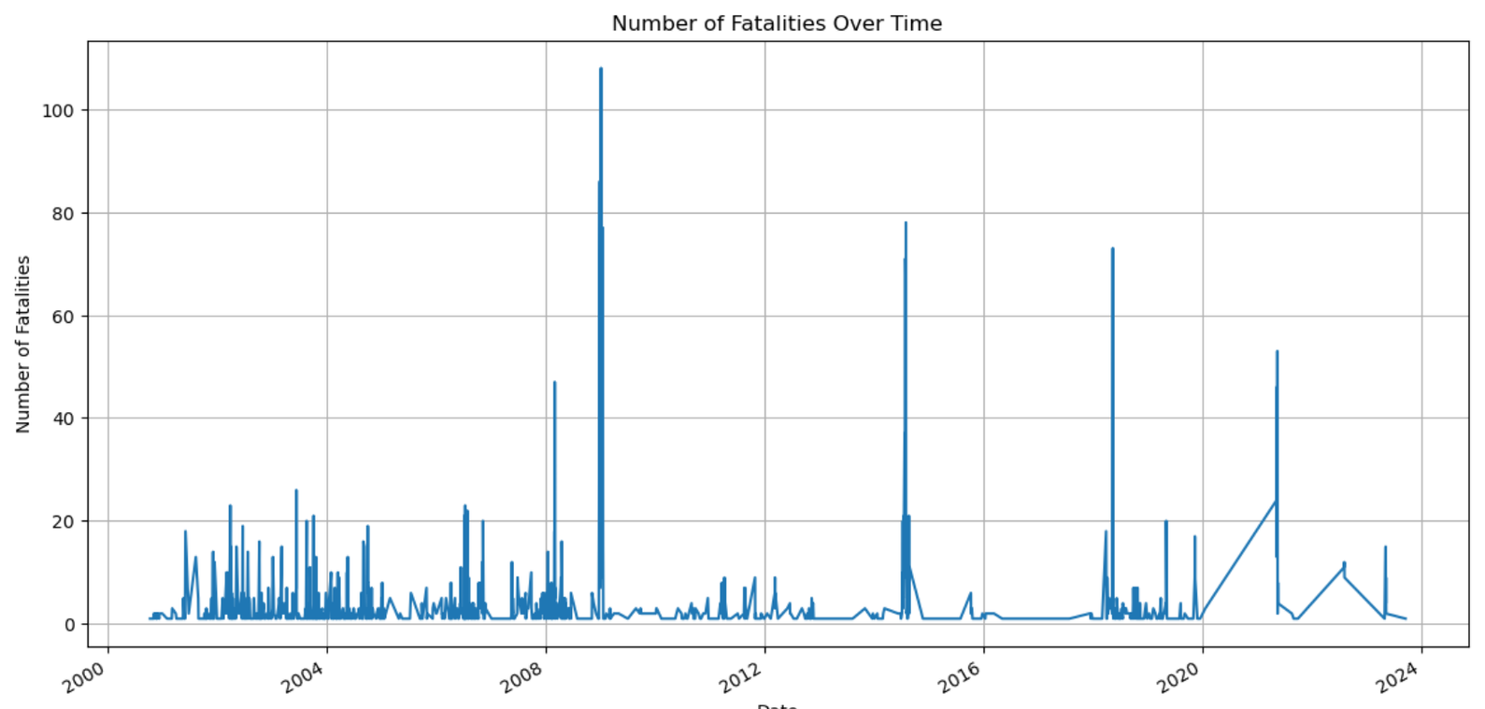
TEMPORAL TRENDS
The line plot of fatalities over time shows fluctuations, with certain periods having significant peaks. These peaks likely correspond to major conflicts or escalations within the timeframe (2000 to 2023).
There may be periods of relative calm or lower fatality rates, which can indicate ceasefires or peace negotiations.

Slide 9
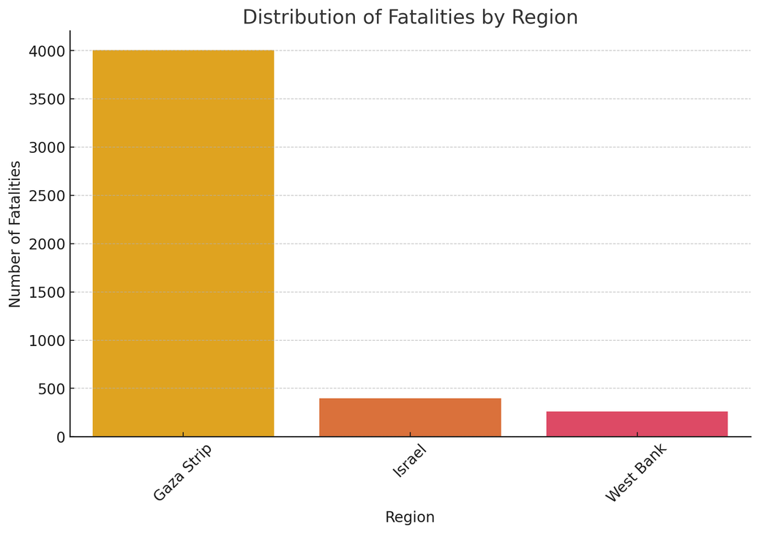
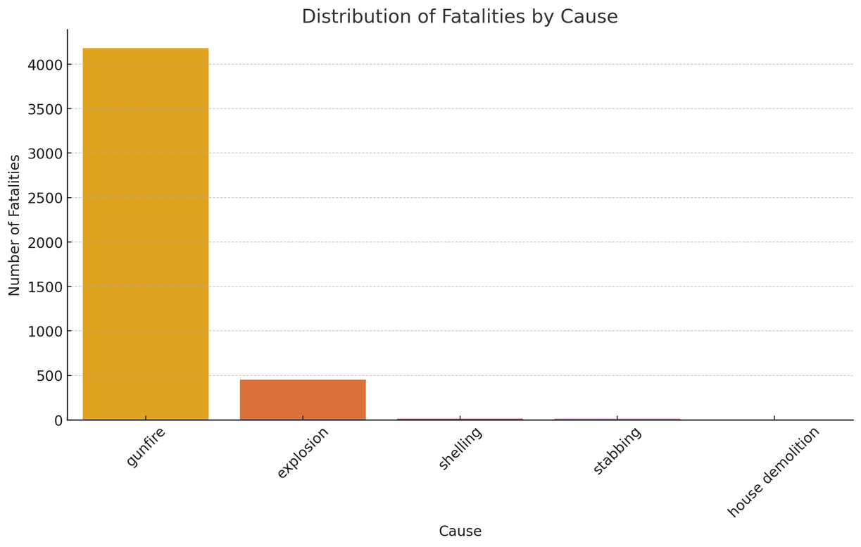
REGIONAL ANALYSIS
CAUSES OF FATALITIES
The distribution of fatalities by region highlights the areas most affected by the conflict. Specific regions (e.g., Gaza, West Bank) have higher fatality counts, indicating hotspots of violence and conflict.
This distribution can help in understanding the geographical spread and focus areas of the conflict.
The count plot of fatalities by cause reveals that certain types of injuries (e.g., gunfire, missile) are more common.
This provides insights into the nature of the conflict and the predominant methods of violence used.

Slide 10
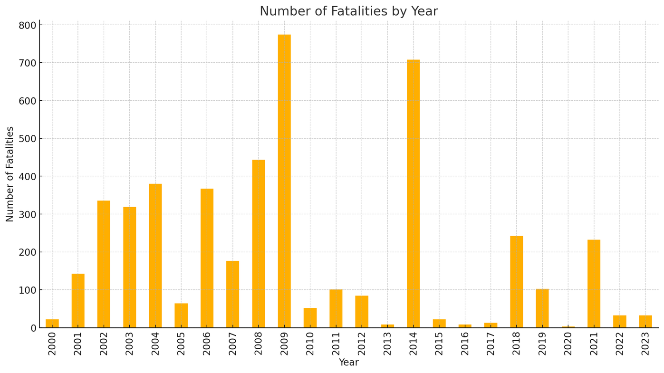
YEARLY TRENDS
The bar plot showing the number of fatalities by year highlights specific years with notably higher or lower numbers of fatalities.
This information can be correlated with historical events, such as major military operations, peace agreements, or changes in political leadership.

Slide 11
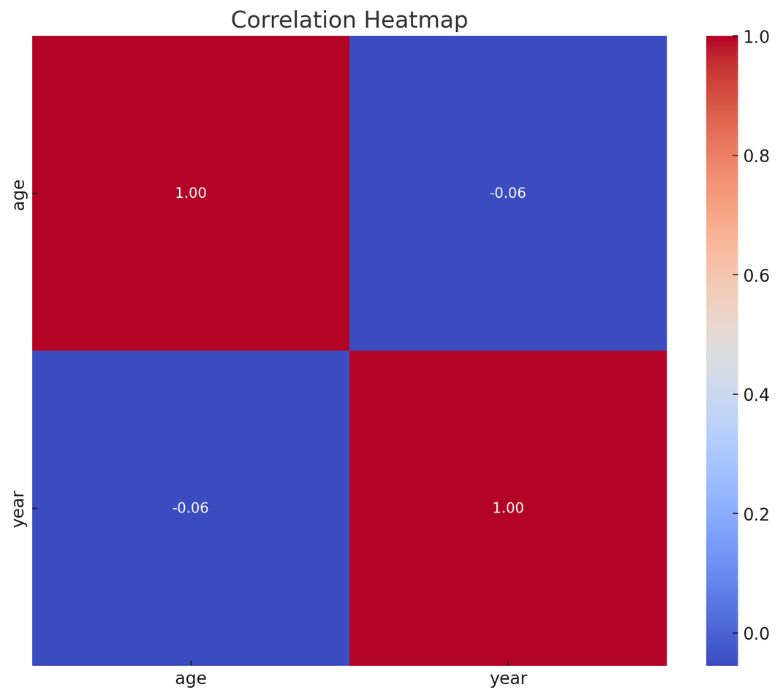
CORRELATION ANALYSIS
The correlation heatmap helps in identifying relationships between different numerical variables in the dataset.
However, given the nature of the data (mostly categorical), there may be limited numerical correlations. The primary numerical variable in this context is age, which may not show strong correlations with other factors.

Slide 12
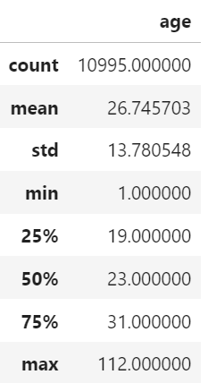
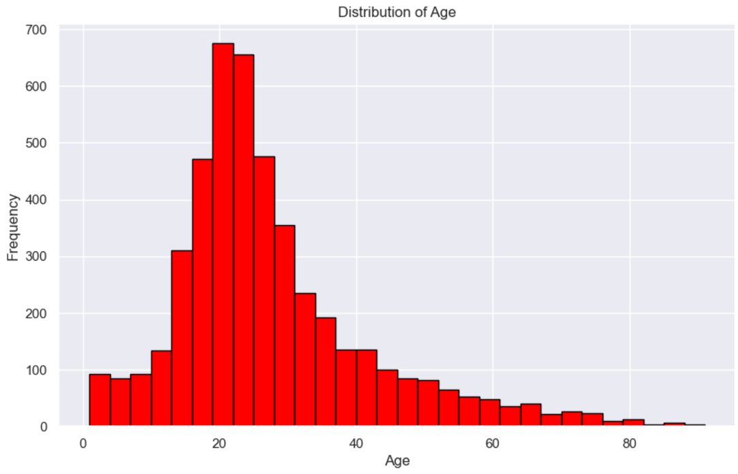
AVERAGE AGE OF DECEASED
PRIMARY VICTIMS:
Average age: 26 years old.
Age range: Youngest 1 year old, Oldest 112 years old.
Majority of fatalities are young people and children, particularly those aged between 15 and 30.

Slide 13
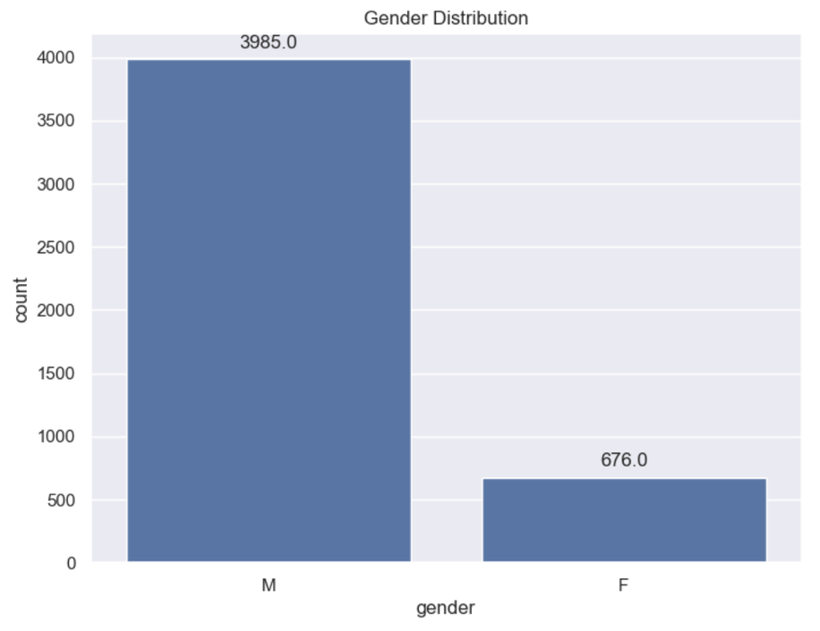
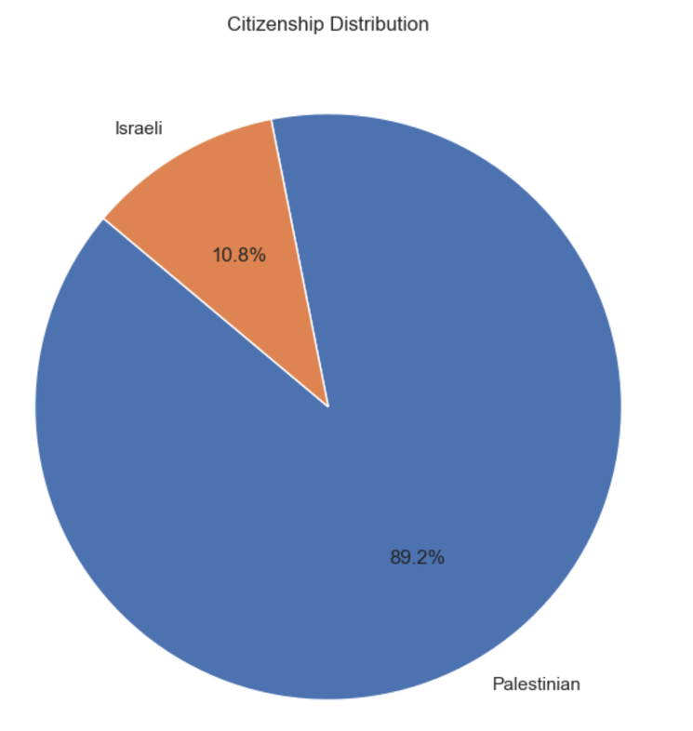
EQUAL IMPACT ON GENDERS
PREDOMINANTLY PALESTINIAN VICTIMS
Both men and women are equally affected by the conflict with no differentiation.
89.2% of the total fatalities are Palestinians, indicating a disproportionate impact on the Palestinian population.

Slide 14
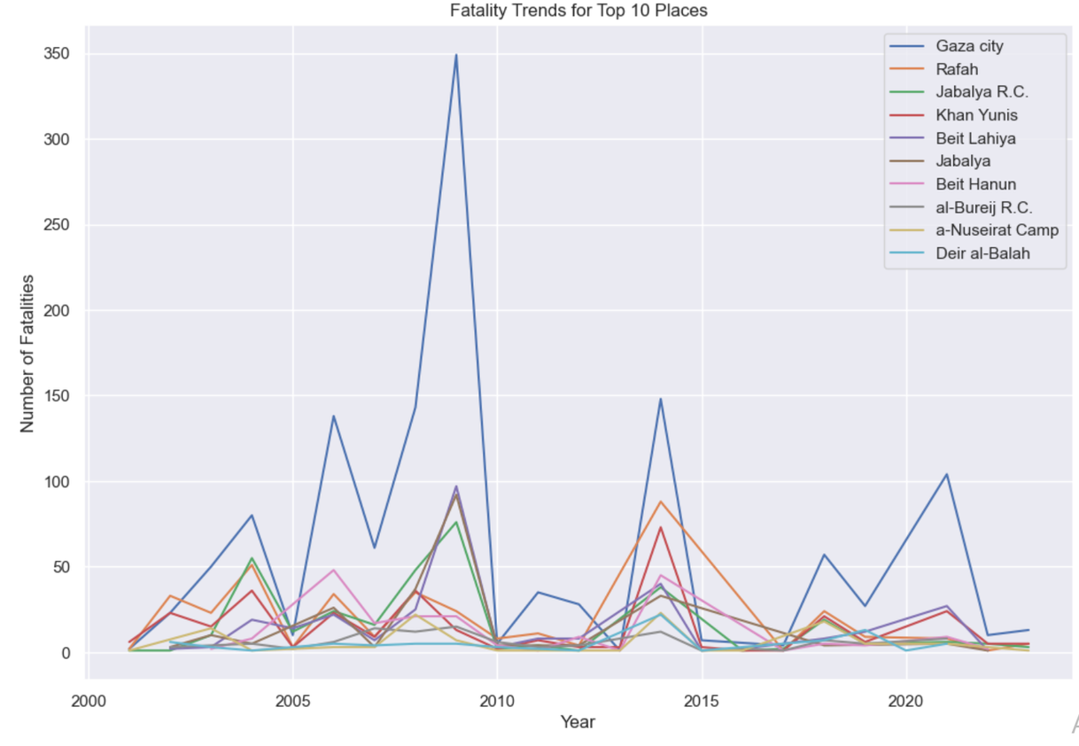
HIGH-FATALITY DISTRICTS
Gaza city (represented by the blue line) consistently shows the highest number of fatalities throughout the period, with several significant spikes.
There are notable peaks in fatalities for most locations around 2008-2009 and 2014, likely corresponding to major conflicts or operations in those years.
The highest spike for Gaza city is around 2008-2009, reaching nearly 350 fatalities.
Other locations like Rafah, Khan Yunis, and Jabalya R.C. also show significant fatalities, but generally lower than Gaza city.
The year 2014 shows a significant spike for multiple locations, likely corresponding to a major conflict event.

Slide 15
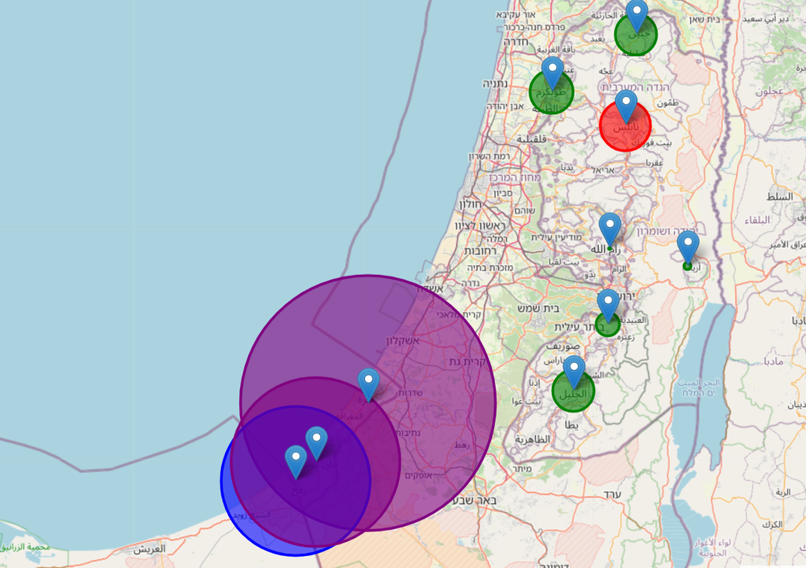
INTERACTIVE MAP
This visualization would provide a geographical representation of the fatalities, allowing viewers to quickly identify which areas have been most affected by the conflict. The color coding and size of the circles offer an immediate visual understanding of the severity of fatalities in each district.
Purple for over 500 fatalities
Bluefor 100-500 fatalities
Red for 50-100 fatalities
Green for less than 50 fatalities

Slide 16
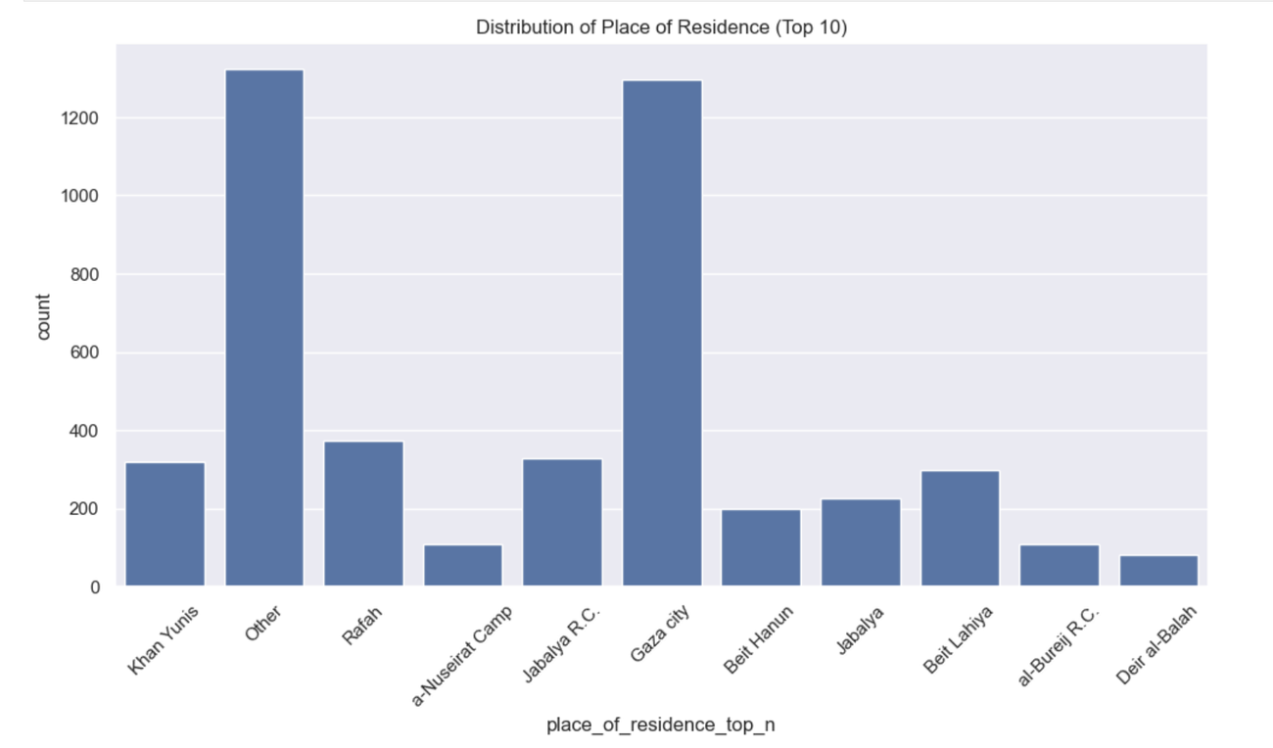
DISTRIBUTION OF PLACE OF RESIDENCE
This visualization provides a clear picture of which areas have suffered the most fatalities, highlighting the concentration of conflict-related deaths in certain locations, particularly within Gaza. It also shows the widespread nature of the conflict, as evidenced by the large "Other" category.
Gaza city and "Other" have the highest counts, both around 1300-1400 fatalities.
Khan Yunis and Rafah follow as the next highest, with approximately 300-400 fatalities each.
There's a significant drop-off after the top 4 categories.

Slide 17
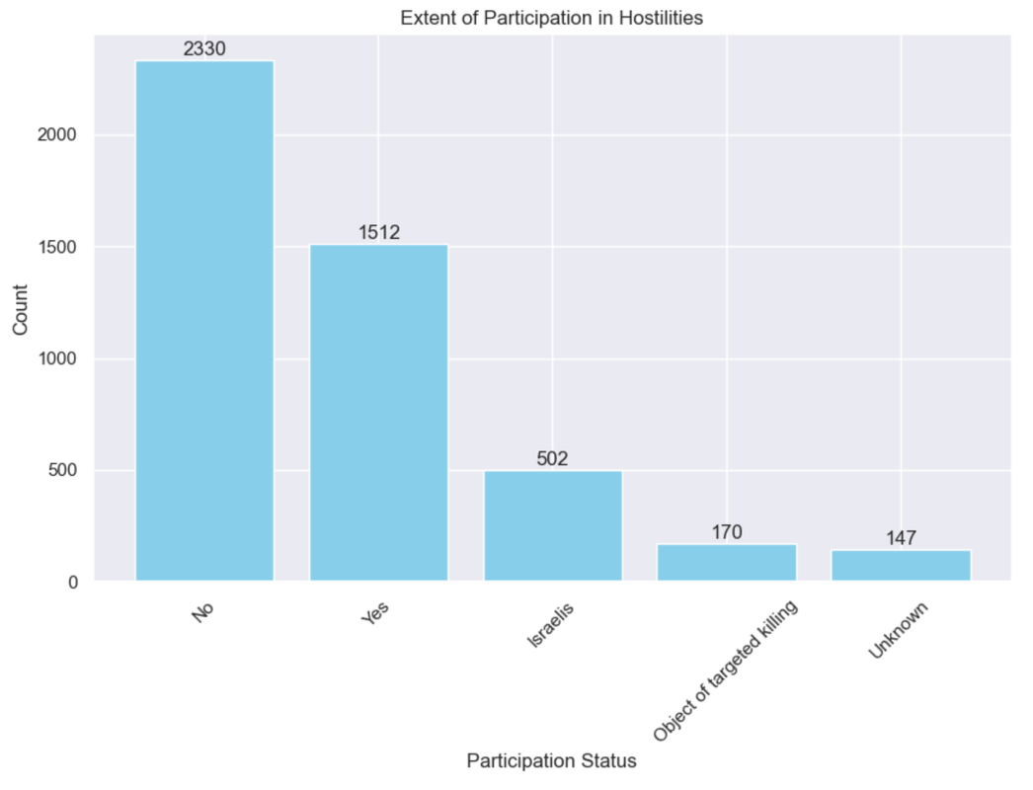
DISTRIBUTION BASED ON PARTICIPATION IN HOSTILITIES
The graph shows that the majority of the dead had no participation in the hostilities, accounting for about 50 percent of the total dead.
Next, we can see that about 36 percent of the dead took part in the hostilities
About 3 percent are not known, 11 percent were killed by the Israelis, while 4 percent of the dead were targeted.

Slide 18
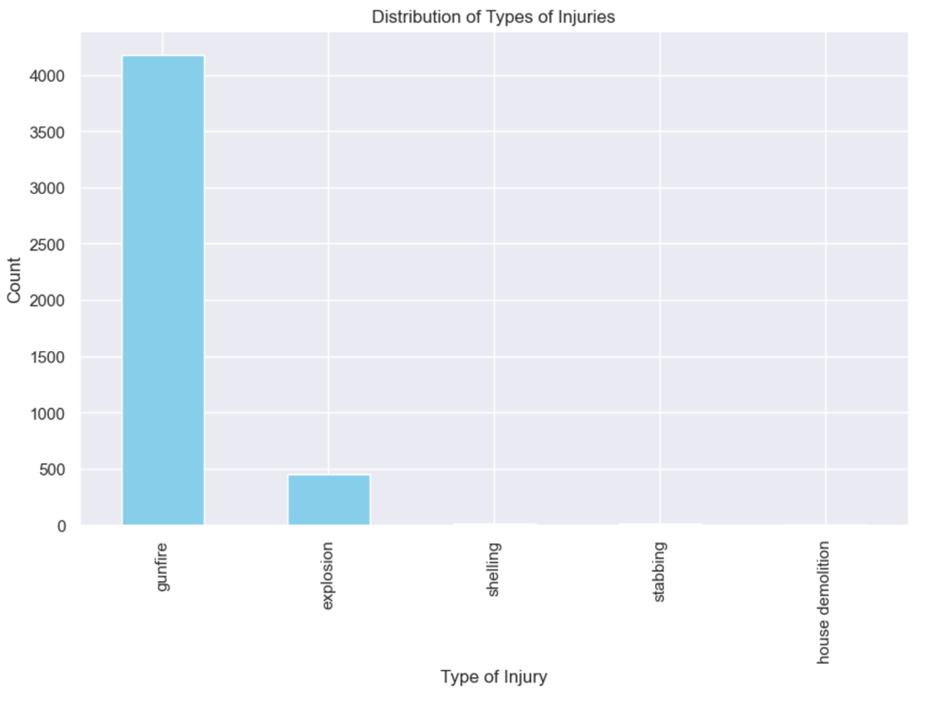
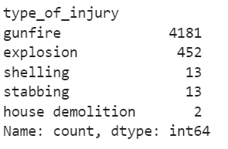
DISTRIBUTION OF TYPES OF INJURIES
The graph shows that 90 percent of deaths were by firearm.
We can also see deaths by explosion account for 10% of the total deaths recorded

Slide 19
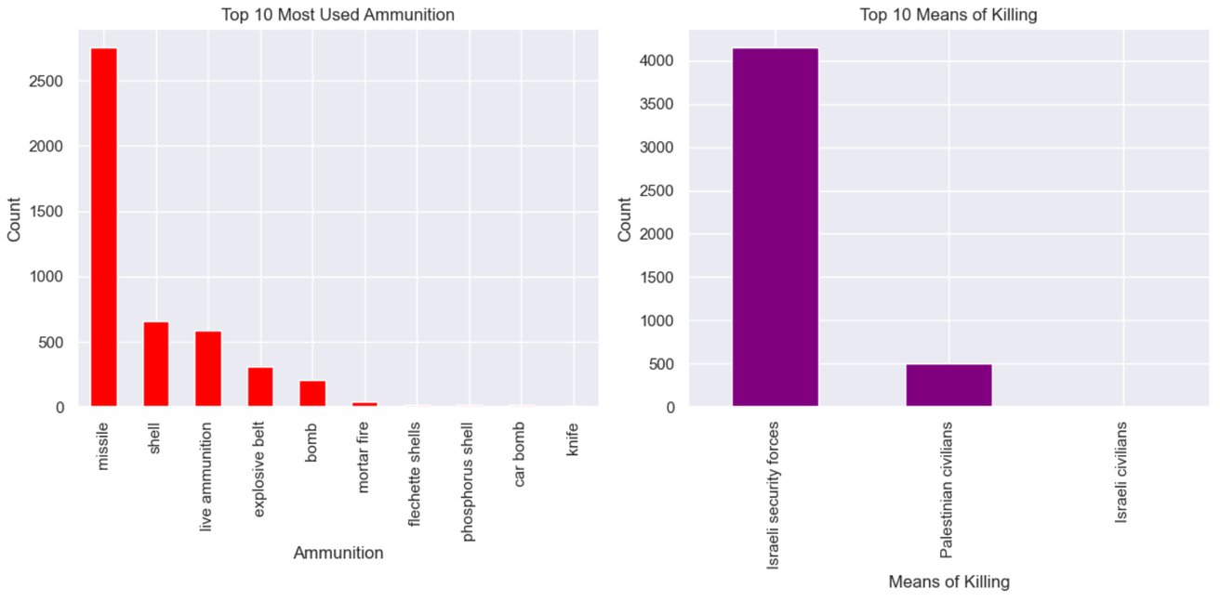
These visualizations provide a sobering look at the nature of the conflict, highlighting both the methods used and the parties most responsible for fatalities.
The conflict involves a wide range of weaponry, with missiles being the predominant type of ammunition used.
There's a stark imbalance in the means of killing, with Israeli security forces being responsible for significantly more fatalities than other groups.
The data suggests that the conflict is largely one-sided in terms of fatalities, with Palestinian civilians suffering the most casualties.
The use of various types of ammunition, including controversial ones like phosphorus shells, indicates the intensity and complexity of the conflict.

Slide 20
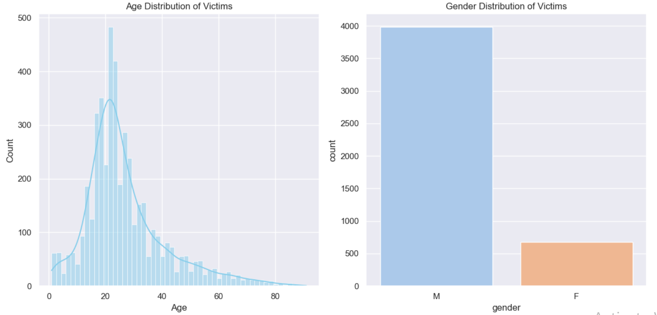
These visualizations highlight the human toll of the conflict, showing that it impacts a wide range of ages but particularly young men. The data underscores the severity of the conflict and its broad impact on the population.
The conflict disproportionately affects young adults and adolescents.
There's a significant number of child victims.
Men are much more likely to be victims than women in this conflict.
The age distribution suggests that many victims are of fighting age, but the presence of very young and old victims indicates that civilians of all ages are affected.

Slide 21
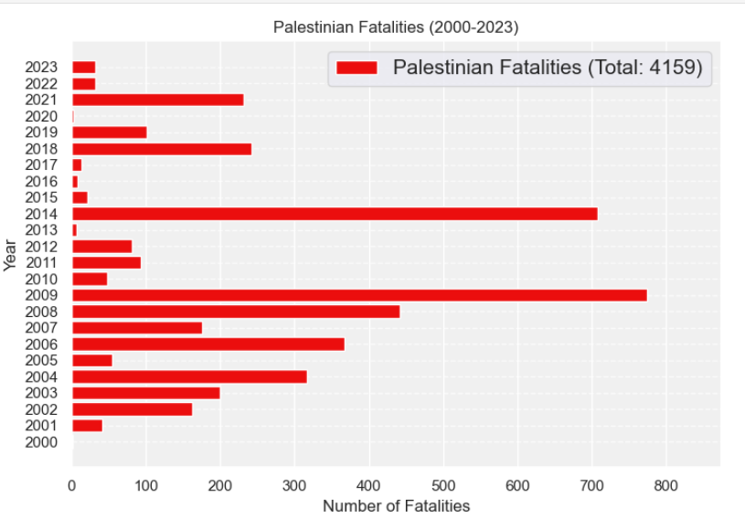
Total Palestinian Fatalities: The chart indicates a total of 4,159 Palestinian fatalities over the 2000-2023 period.
Significant Spikes:
2002: The highest number of fatalities, around 750, coinciding with the Second Palestinian Intifada and events like the Jenin massacre.
2014: Another major spike with approximately 700 fatalities, linked to the 2014 Gaza War (Operation Protective Edge).
2009: A notable increase, with over 800 fatalities, possibly related to Operation Cast Lead (2008-2009).
Moderate Peaks:
2001, 2003-2005: Elevated fatalities during these years, reflecting ongoing conflict and violence throughout the Second Intifada.
2018: Another peak, likely due to escalated tensions and conflict incidents like the Great March of Return protests.
Periods of Decrease:
2006-2008, 2010-2013, 2016-2017: Relatively lower fatality rates during these periods, indicating temporary reductions in fatal violence.
Recent Trends:
2020-2023: Noticeable spikes, especially in 2021, which may be attributed to escalations such as the 2021 Gaza-Israel clashes.

Slide 22
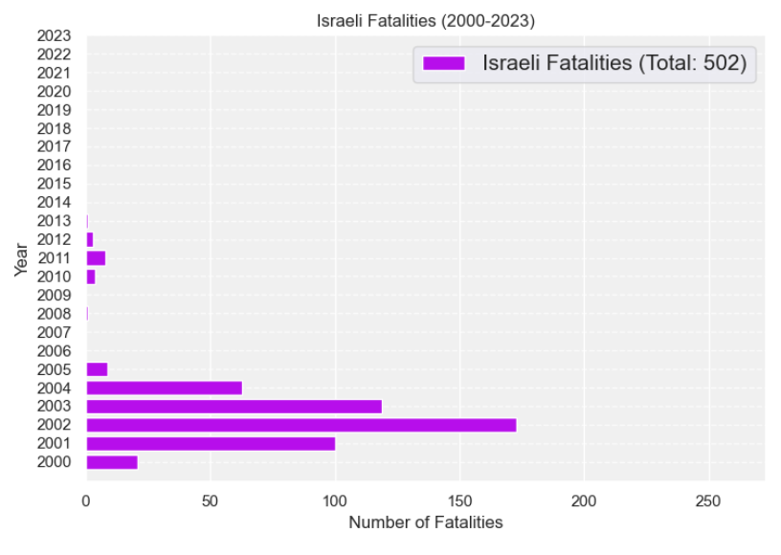
Total Israeli Fatalities: The chart indicates a total of 502 Israeli fatalities over the 2000-2023 period.
Trend Observations:
The number of Israeli fatalities is generally lower compared to the Palestinian fatalities shown in the previous chart.
The trend appears more stable, with fewer dramatic spikes or fluctuations over the years.
The highest number of Israeli fatalities occurred in the early 2000s, particularly in 2002 and 2003, which likely corresponds to the Second Palestinian Intifada.
After 2003, the number of Israeli fatalities declined and remained relatively lower, with some minor variations in the following years.
Specific Years:
2002-2003: The peak years, with around 200 and 150 Israeli fatalities, respectively.
2004-2007: Elevated but declining number of fatalities during this period.
2008-2023: Relatively lower and more stable number of Israeli fatalities, with some minor fluctuations.
Overall, the Israeli Fatalities chart presents a contrasting picture to the Palestinian Fatalities chart, showing a less volatile trend and a significantly lower total number of fatalities on the Israeli side compared to the Palestinian side over the 2000-2023 period.

Slide 23
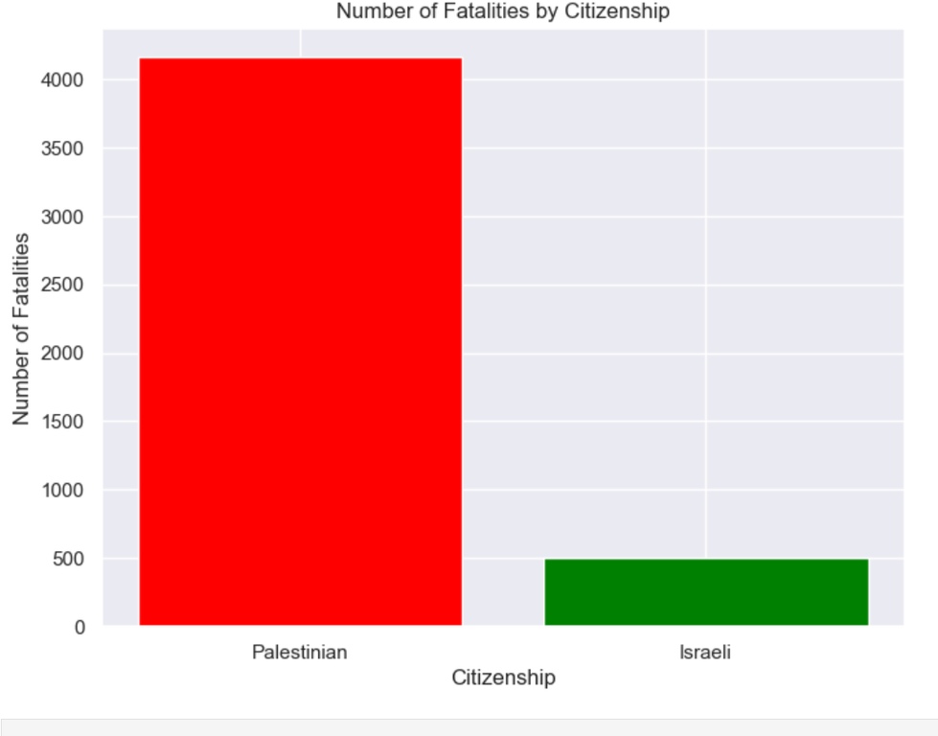
Palestinian Fatalities:
The chart shows a total of 4,159 Palestinian fatalities.
The entire chart is colored in red, indicating that the vast majority of fatalities are Palestinian.
Israeli Fatalities:
The chart shows a total of 502 Israeli fatalities.
The bar for Israeli fatalities is much smaller compared to the Palestinian fatalities, shown in green.
The stark contrast between the two charts highlights the disproportionate impact of the conflict on the Palestinian population, with Palestinian fatalities being significantly higher than Israeli fatalities over the 2000-2023 period covered in the data.

Slide 24
SUMMARY
From 2018 to 2023, there was a gradual increase in the number of fatalities.
This increase in fatalities is attributed to the Second Palestinian Intifada, a period of heightened violence and conflict between Israelis and Palestinians.
The 2014 Gaza War, also known as Operation Protective Edge, which saw the highest death toll during the 2000-2023 period covered in the data.
The 2014 Gaza War involved military operations and mutual bombings between Israel and Palestinian resistance groups like Hamas and Islamic Jihad, leading to significant civilian casualties on both sides.
The stated aim of the Israeli operation was to stop rocket fire from Gaza into Israel, while Hamas sought to gain international pressure to lift the blockade on Gaza and end the Israeli offensive.
There are conflicting claims about who broke the ceasefire agreement prior to the 2014 war, with Israel stating it was a response to rocket fire, while others claim Israel was the first to break the ceasefire.

Slide 25
NOTABLE HISTORICAL EVENTS AND TRENDS
Jenin Massacre (2002)
Mass Killings:
Significant spike in fatalities during the Jenin massacre.
Israeli Army Incursion:
Reports highlight indiscriminate killings, use of human shields, and denial of medical assistance by Israeli forces.
Comprehensive Invasion of the West Bank
Fierce Battles:
Aim to neutralize armed Palestinian groups, leading to extensive casualties and displacement.
War Crimes and International Reactions
Violations:
Use of heavy artillery and war crimes committed by Israeli forces, leading to international outcry.
Decline in Fatalities Post-2002
Decrease in Numbers:
Lower fatality rates post-2002, but ongoing crimes continued against civilians.
Rise in Fatalities (2005-2008)
Second Palestinian Intifada:
Increase in fatalities attributed to the Second Intifada during this period.
2014 Gaza War
Operation Protective Edge:
Highest death toll observed during the 2014 Gaza War between Israeli forces and Palestinian resistance movements.
Intense mutual bombings and targeted strikes, leading to significant civilian casualties.
Post-2014 Trends
Decreased Fatalities:
Observed decrease in fatalities post-2014, although fluctuations indicate ongoing tensions from 2018 to 2023.

Slide 26

THE END

